Slide 1
Scooter city
A new era in human transportation
A study on the effect of crime rate due to the introduction of dockless motorized scooters

Slide 2
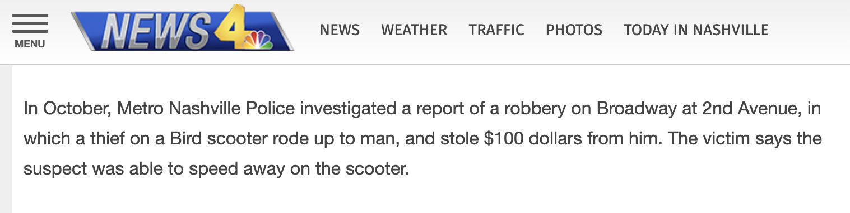
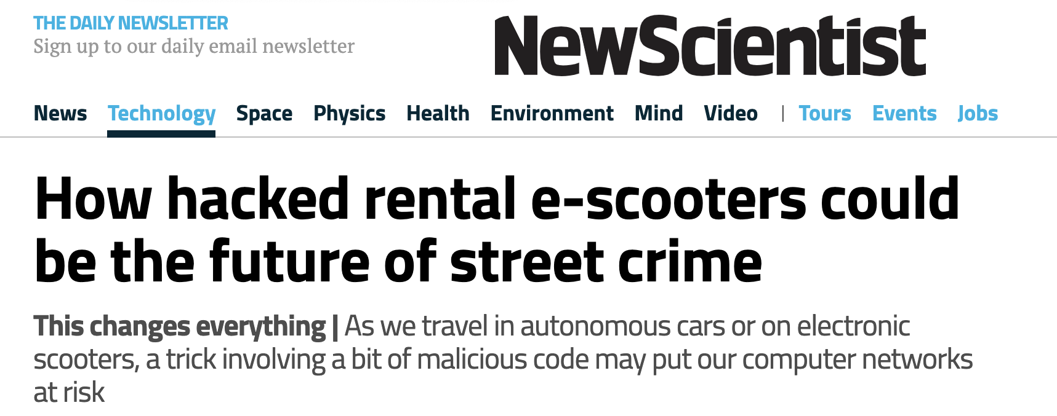
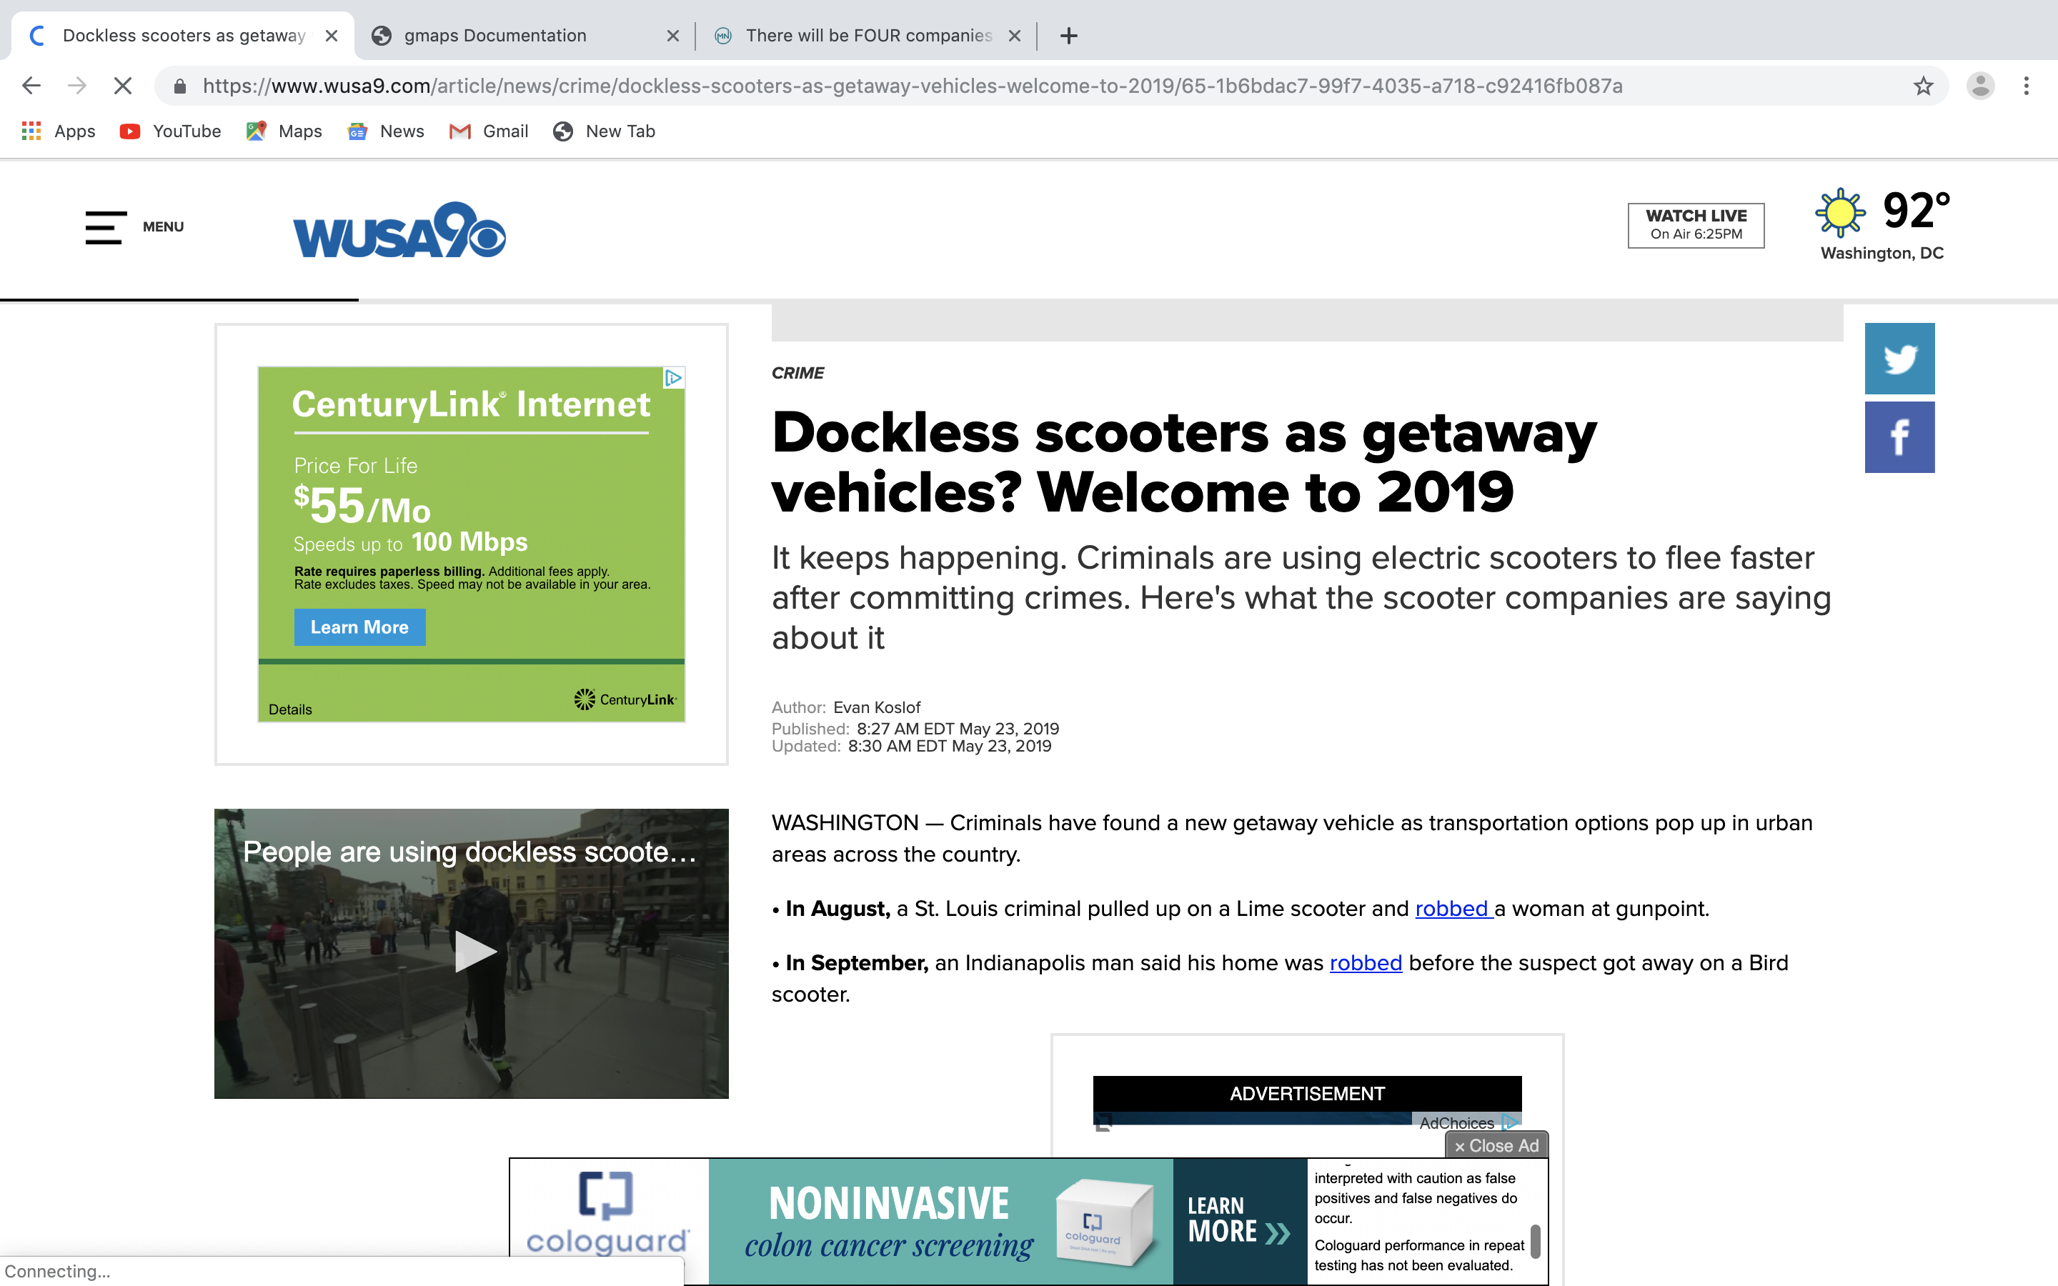
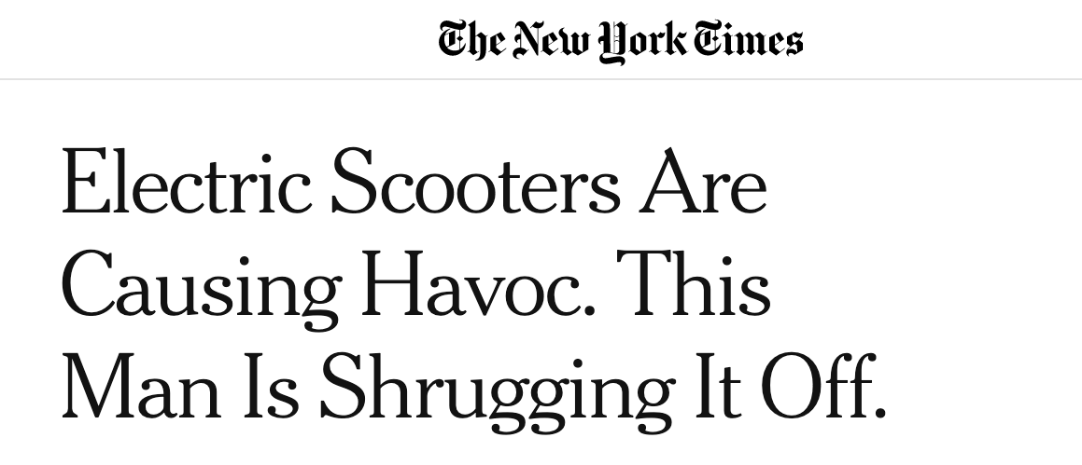
Why is this issue important?
Today, 126 US cities have “dockless” scooter operations
Reports from across the country indicate the nefarious rise in scooter crime
Minneapolis has recently approved dockless scooters

Slide 3
Summary of the study
Our hypothesis is that introduction of dockless scooters has increased the crime rate in Minneapolis.
We found crime data via www.minneapolisopendata.com????, and scooter rental data via www.scooterdata.com????
We determined the relationship between the rate of individual crimes and scooter rental data, and determine whether a correlation existed
Despite the seasonal effect on crime in Minneapolis, we were able to eliminate this phenomenon to determine that petty crimes decreased during the 4 month scooter pilot study.

Slide 4
The proximity to scooters and crime
Elaborate on the questions you asked, describing what kinds of data you needed to answer them, and where you found it, and how you cleaned it

Slide 5
The seasonal effect on crime in Minneapolis
Elaborate on the questions you asked, describing what kinds of data you needed to answer them, and where you found it, and how you cleaned it

Slide 6
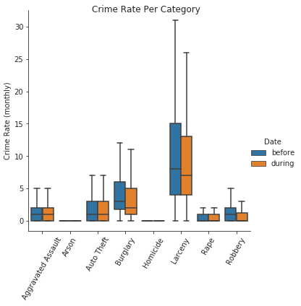
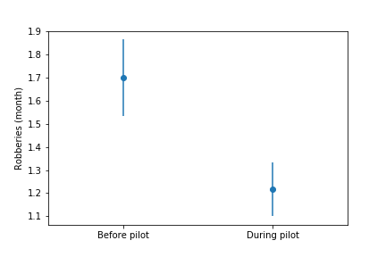
Digging into the numbers
Adding a “Date” column to the datable to delineate whether the crime happened before or during the scooter trial period (data visualized via Seaborn factor plot (hue = “Date)
Using numpy ttest, four categories show significant decline (Robbery, AggAssault, Burglary and Arson)

Slide 7
Discussion
We were surprised to find that our hypothesis turned out to be false
Crime actually decreased in four categories, which happen to be “less severe” crimes than the four that didn’t show any effect

Slide 8
Post Mortem
Discuss any difficulties that arose, and how you dealt with them
Discuss any additional questions that came up, but which you didn't have time to answer: What would you research next, if you had two more weeks?

Slide 9
Questions?

